Slide 1
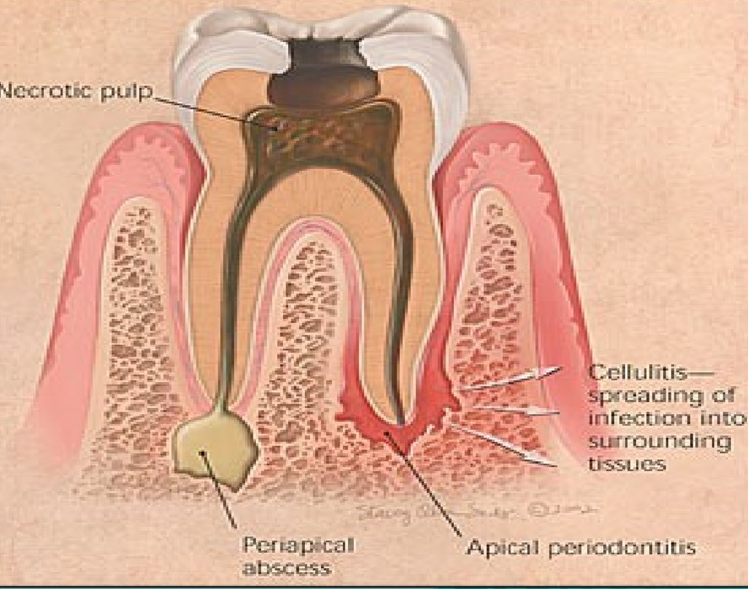
PULPAL AND PERIRADICULAR PATHOLOGY – ETIOLOGY AND MANAGEMENT

Slide 2
The dental pulp is a delicate connective tissue liberally interspread with tiny blood vessels, lymphatic's, myelinated & unmyleinated nerves & undifferentiated connective tissue cells.
Like any other connective tissues in the body it reacts to bacterial infection / to other stimuli by an inflammatory response known as pulpitis

Slide 3
It is encased by hard tissues dentin & enamel.
The blood vessels supplying the pulp tissue must enter the tooth through the tiny apical foramina precludes the development of an extensive collateral blood supply to the inflamed part.

Slide 4
Pulp responds to any stimuli as pain.
Temperature of 16-55 oc – tolerated by pulp - temperature above this is perceived as pain

Slide 5
ETIOLOGY OF PULPAL DISEASE
Pulp responds to any external stimuli by activation of odontoblasts - these form reparative dentin – protect the underlying pulp- severe injury – necrosis of cells
Etiologic agents are broadly divided into 3 groups

Slide 6
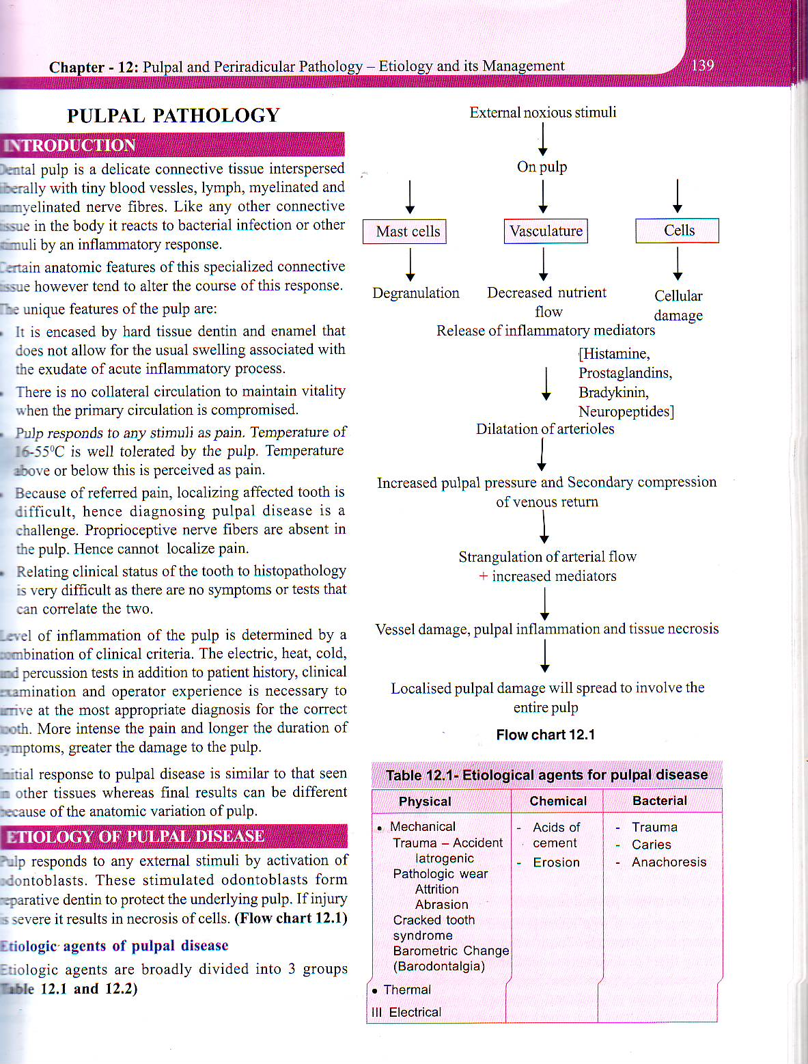

Slide 7
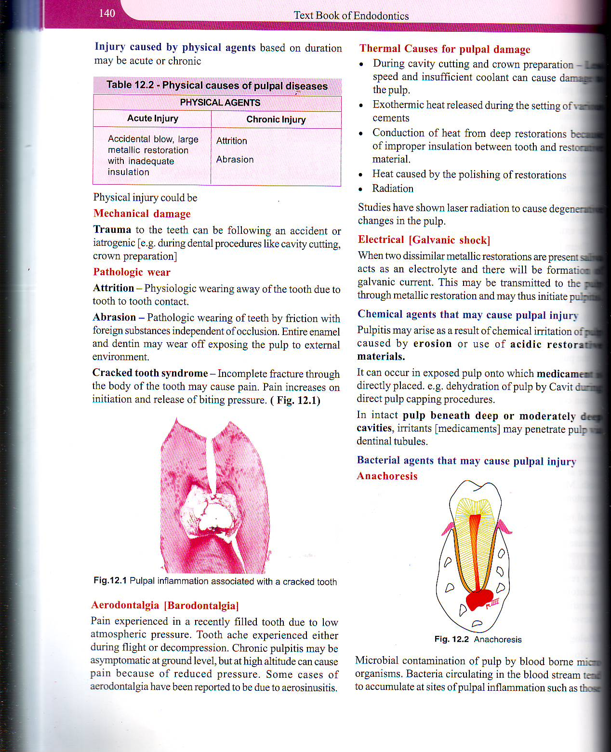
Injury caused by physical agents based on duration – acute / chronic

Slide 8
According to Grossman
1) Physical
a) mechanical
Trauma – accidental, iatrogenic
Pathologic wear – attrition , abrasion
Cracked tooth syndrome
Barodontalgia ( Aerodontalgia)
b) Thermal – cavity preparation, setting of cement, deep fillings without protective base, polishing.
c) Electrical ( galvanic shock)

Slide 9
2) Chemical
- phosphoric acid, acrylic monomer
- erosion
3) Bacterial
- toxins associated with caries
- direct invasion of pulp from caries or trauma
- anchoress.

Slide 10
RESPONSE OF DENTIN PULP COMPLEX TO INJURIOUS STIMULI
DENTIN– Formation of reparative dentine
- Dentinal slerosis
DIRECT PULPAL RESPONSE - Elimination / neutralization of damaging factors & initiating tissue repair
Cellular damage to pulp
Release of vasoactive mediators
CAUSES
Chemostactic mediators
&
Vasodilation
Attract specific inflammatory cells
Production of immunoglobulins – IgG, IgA, IgM against bacterial antigens of dental caries

Slide 11
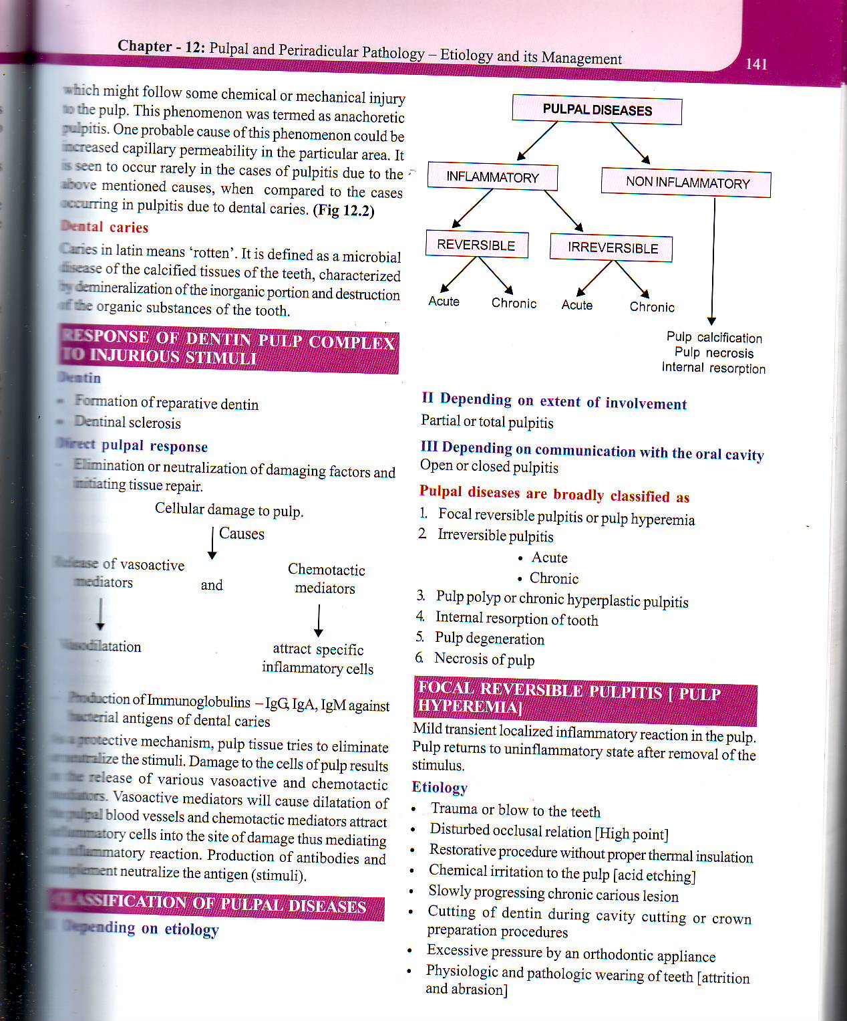
CLASSIFICATION OF PULPAL DISEASES
1. Depending on etiology

Slide 14
FOCAL REVERSIBLE PULPITIS / PULP HYPEREMIA
Mild transient localized inflammatory reaction in the pulp – pulp returns to normal after removal of the stimulus .

Slide 15
ETIOLOGY
Trauma / blow to the teeth
High point ( occlusal relation is disturbed )
Restorative procedures without proper thermal insulation
Acid etching ( chemical irritation to the pulp)
Slowly progressing chronic carious lesion
Cutting of dentin ( cavity prep) / crown preparation
Excessive pressure - ortho appliance
Physiological and pathological wearing of teeth ( attrition &abrasion)
Rapid separation of teeth – mechanical separators

Slide 16
CLINICAL FEATURES
Sensitive to thermal changes – cold stimulus – pain
Pain of shorter duration ( few sec)
sharp pain – disappears – on stimulus removal

Slide 17
DIAGNOSIS
Pain (described ) – sharp , chronic in nature
Sensitive to thermal changes – cold
Normal – percussion , palpation, mobility tests
X-ray – no periapical changes
EPT- affected pulp responds to lower level of current

Slide 18
TREATMENT
Identify the cause – treat
Reduce high points
Proper insulation of restorations
Treat incipient carious lesions

Slide 19
IRREVERSIBLE PULPITIS
Is a persistent inflammatory condition of the pulp, caused by noxious stimuli and the condition may be symptomatic or asymptomatic .
In acute cases - spontaneous pain

Slide 20
ACUTE IRREVERSIBLE PULPITIS
Sequelae of reversible pulpitis
Presents as an acute condition
Or acute exacerbation of chronic pulpitis

Slide 21
CLINICAL FEATURES - BROADLY CLASSIFIED INTO
Early asymptomatic stage
Early symptomatic stage
Late symptomatic stage

Slide 22
EARLY ASYMPTOMATIC STAGE
Initial stage – pulp is exposed , pain felt – when cavity is filled with food particles / suction is exerted by the tongue / cheek.
EPT – more current is required to elicit a response

Slide 23
EARLY SYMPTOMATIC STAGE
Thermal changes will initiate pain – cold
Pain – continues –even after removal of the stimulus
Pain – sharp , piercing / shooting pain
In the 1st 2 stages – localized pain
EPT – less current than normal – to elicit a response than the adjacent normal tooth

Slide 24
LATE SYMPTOMATIC STAGE
Spontaneous pain – diffuse , dull throbbing
Pain on bending / lying down – intra pulpal
Difficult to identify the affected tooth – hypersensitive to heat
EPT- INCREASED SENSITIVITY OF PULP . WHEN NECROSIS – SENSITIVITY IS LOST

Slide 25
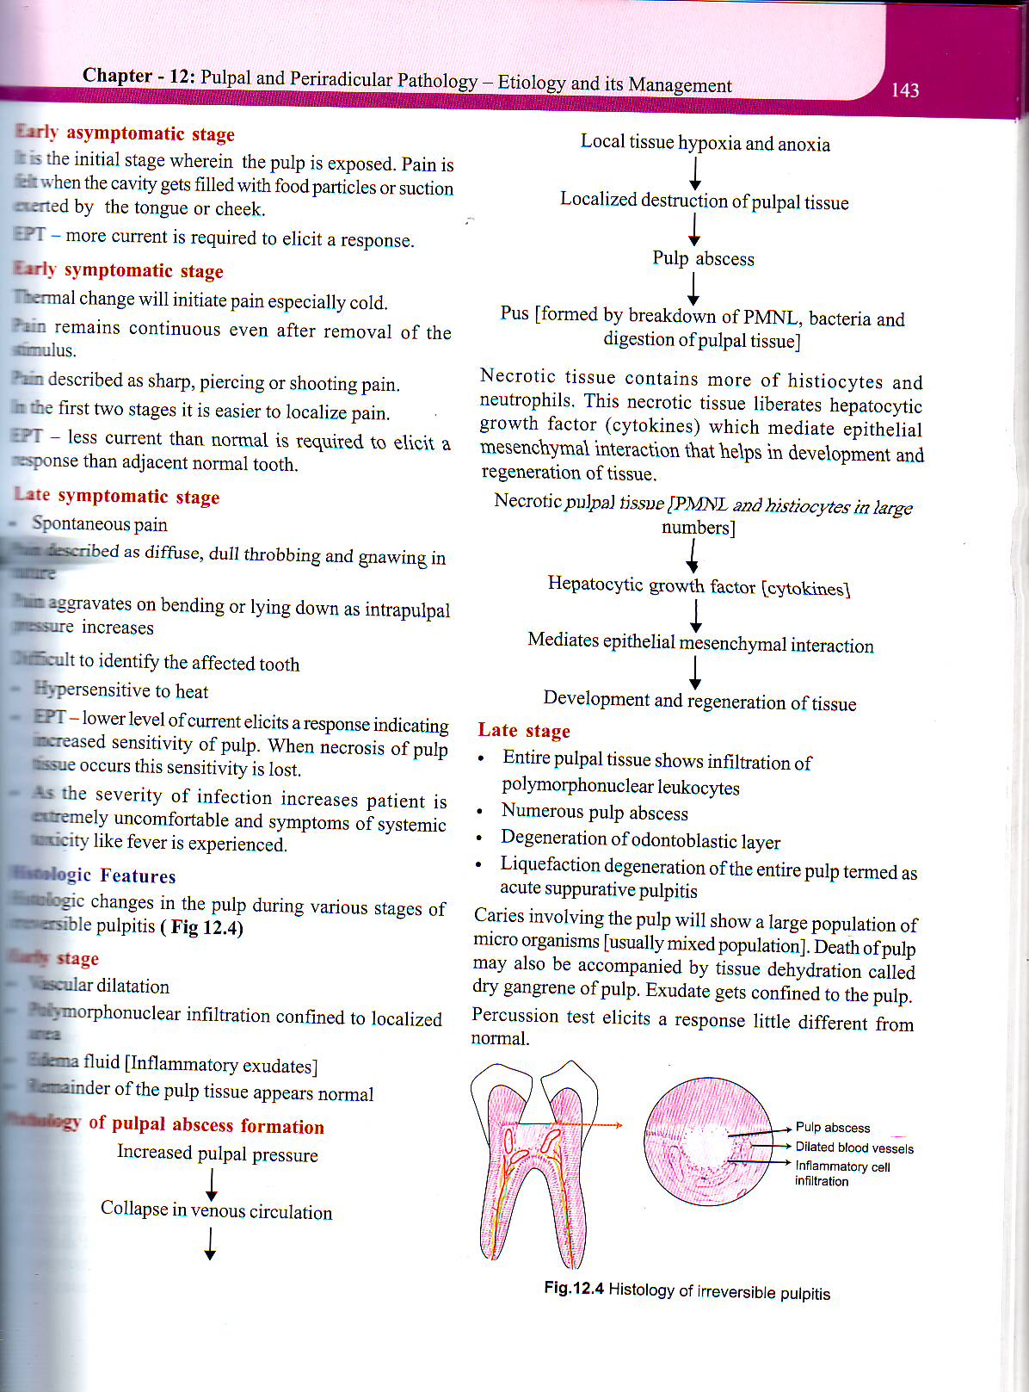
EARLY STAGE
Vascular dilation
Polymorph nuclear infiltration confined to localized area
Edema (inflammatory exudate )
Pulp tissue appears normal

Slide 26
LATE STAGE
Pulp tissue – infiltration of polymorph nuclear leucocytes
Numerous pulp abscess
Degeneration of odontoblastic layer
Liquefaction degeneration of entire pulp – acute suppurative pulpits
Death of the pulp- tissue – accompanied – tissue dehydration – dry gangrene of pulp
Percussion test – response- different from normal

Slide 27
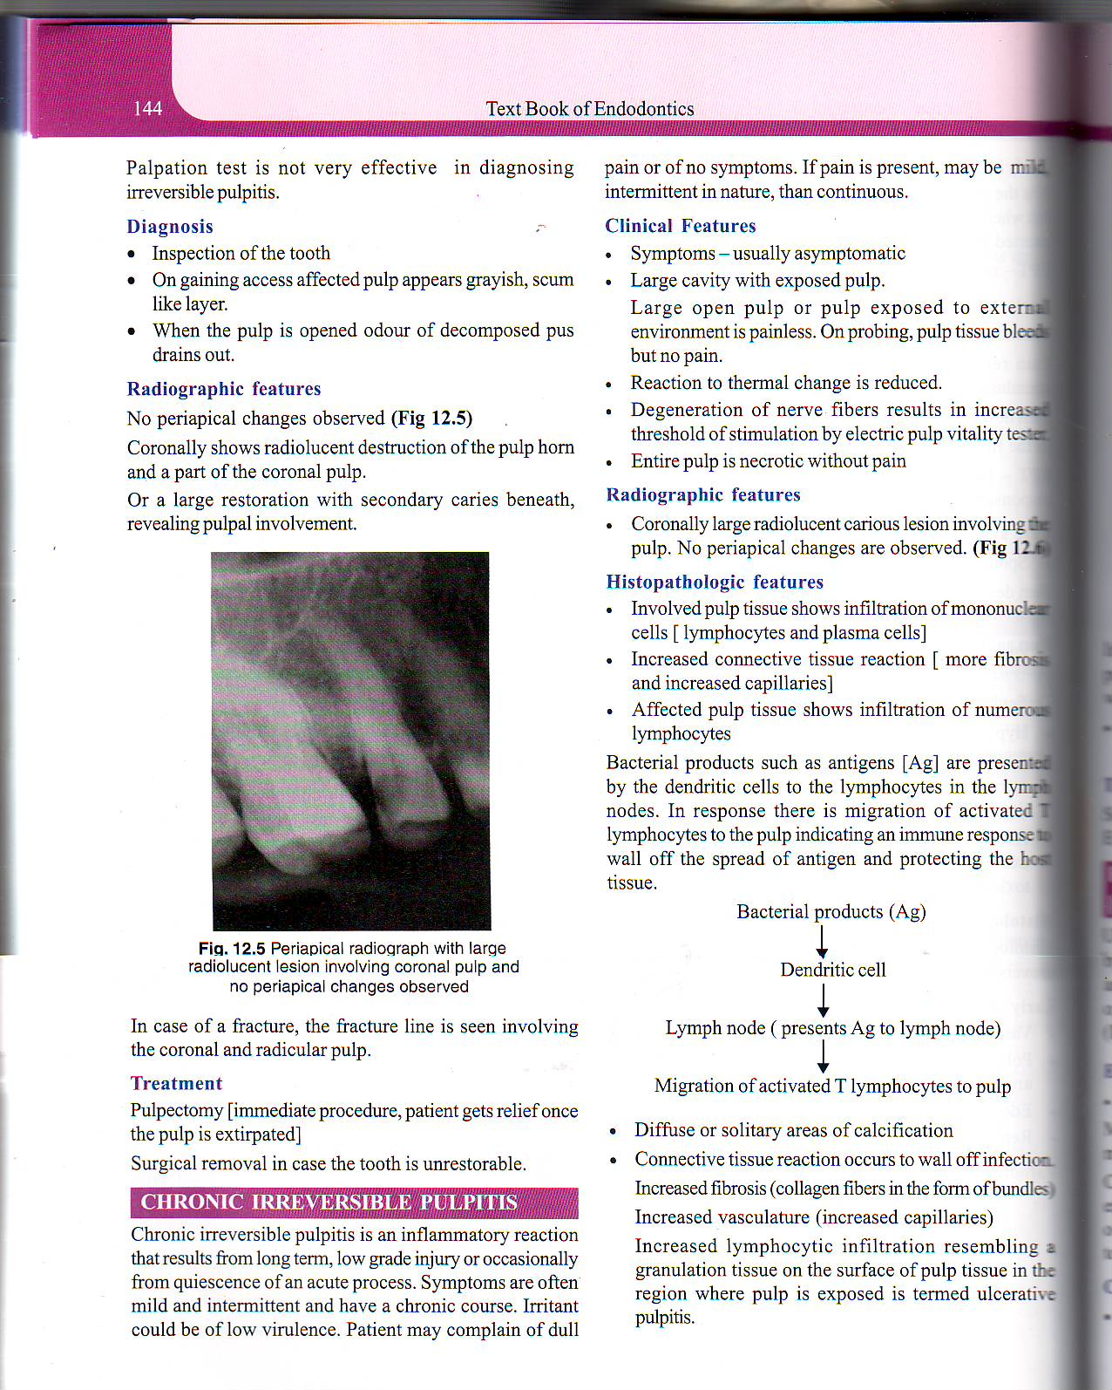

Slide 29
CHRONIC IRREVERSIBLE PUPLITIS
Is a inflammatory reaction that reacts from long term , low grade injury / occasionally from quiescence of an acute process
Symptoms - mild & intermittent – have a chronic course

Slide 30
CLINICAL FEATURES
Asymptomatic
Large cavity – exposed pulp
Large open pulp/pulp exposed to external environment – painless
On probing – pulp tissue bleeds- but no pain
Reaction to thermal change is reduce
Degeneration of nerve fibers – increased pain threshold – EPT
Necrotic pulp without pain

Slide 31
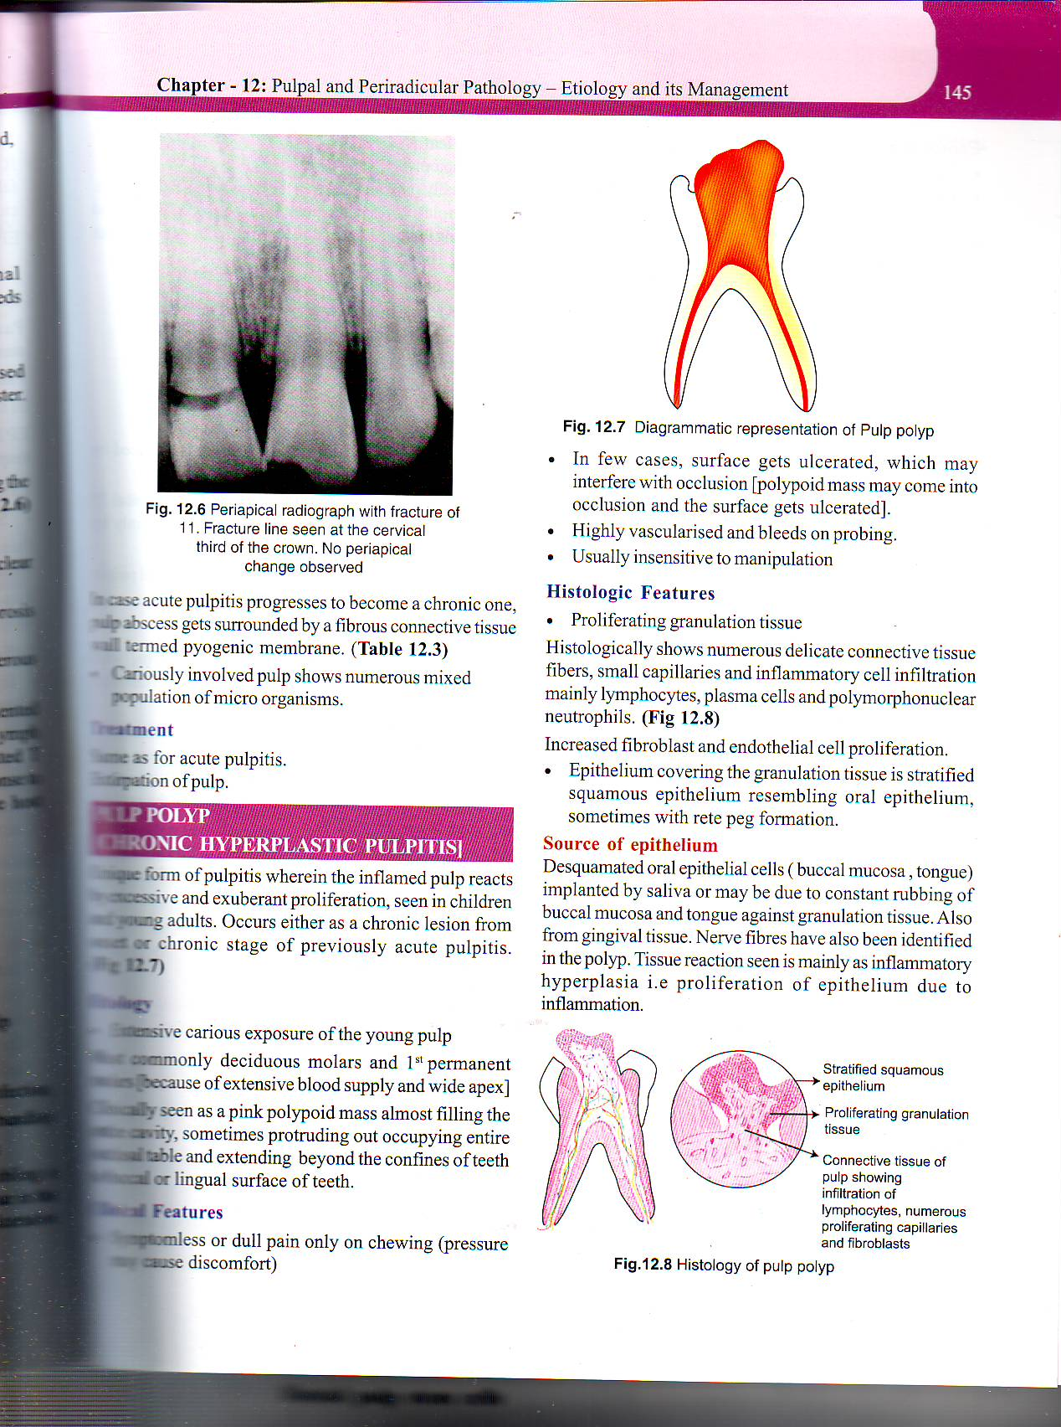
RADIOGRAPHIC FEATURES
Coronally large radiolucent carious lesion involving the pulp
No periapical changes are observed

Slide 32
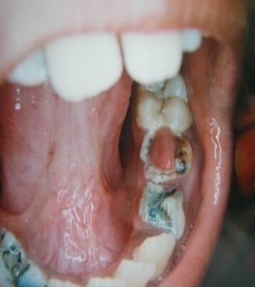
PULP POLYP ( chronic hyperplastic pulpitis)
Extensive carious exposure of the young pulp
Deciduous molars & 1st permanent molars ( extensive blood supply & wide apex
Clinically – pink polypiod mass – filling the entire cavity
ETIOLOGY

Slide 33
Clinical features
Symptomless
Dull pain on chewing ( pressure may cause discomfort )
Bleeds on probing - highly vascular

Slide 34
CAUSES OF PULPAL PROLIFERATION
Large carious exposure
Low grade sustained irritation ( bact / mechanical- chewing )
RADIOGRAPHIC FEATURES - Large carious exposure of pulp involving the entire pulp
THERMAL TEST – may or may not respond
EPT- more current than the normal to elicit a response

Slide 35
DIFFERENTIAL DIAGNOSIS
Hyper plastic gingival tissue ( gingival tissue overgrown into the cavity ) clinically – stalk is seen attached to interdental gingiva on one end
Treatment
Extirpation / removal of both coronal & radicular pulp

Slide 36
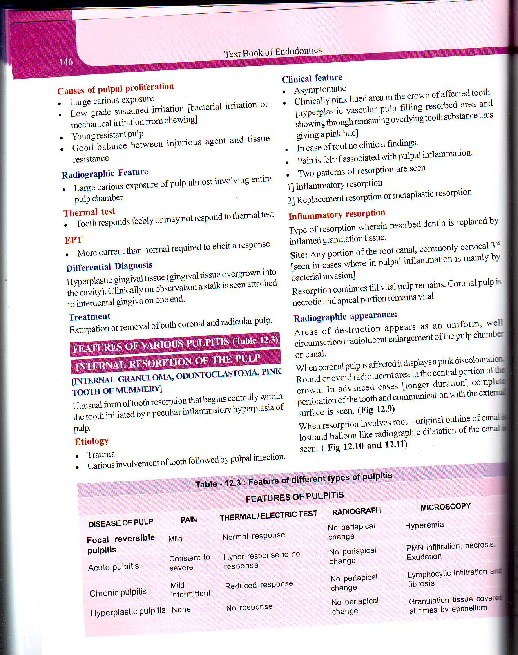
FEATURES OF VARIOUS PULPITIS

Slide 37
INTERNAL RESORPTION OF THE PULP
( Internal granuloma , Odontoclastoma , Pink tooth of mummery )
Resorption begins centrally within the tooth initiated by a peculiar inflammatory hyper plastic of pulp
Trauma
Carious involvement of tooth followed by pulpal infection
ETIOLOGY

Slide 38
CLINICAL FEATURES
Asymptomatic
Clinically pink hued area in the crown of affected tooth
In case of root – no clinical findings
Pain is felt if associated with pulpal inflammation

Slide 39
Two patterns of resorption are seen
Inflammatory resorption
Replacement resorption

Slide 40
INFLAMMATORY RESORPTION
Resorbed dentin is replaced by inflamed granulation tissue
SITE – any portion of the root canal- commonly cervical 3rd ( seen in cases pulpal inflammation is mainly by bacterial invasion )
Resorption continues till vital pulp remains.
Coronal pulp – necrotic , apical pulp portion - vital

Slide 41
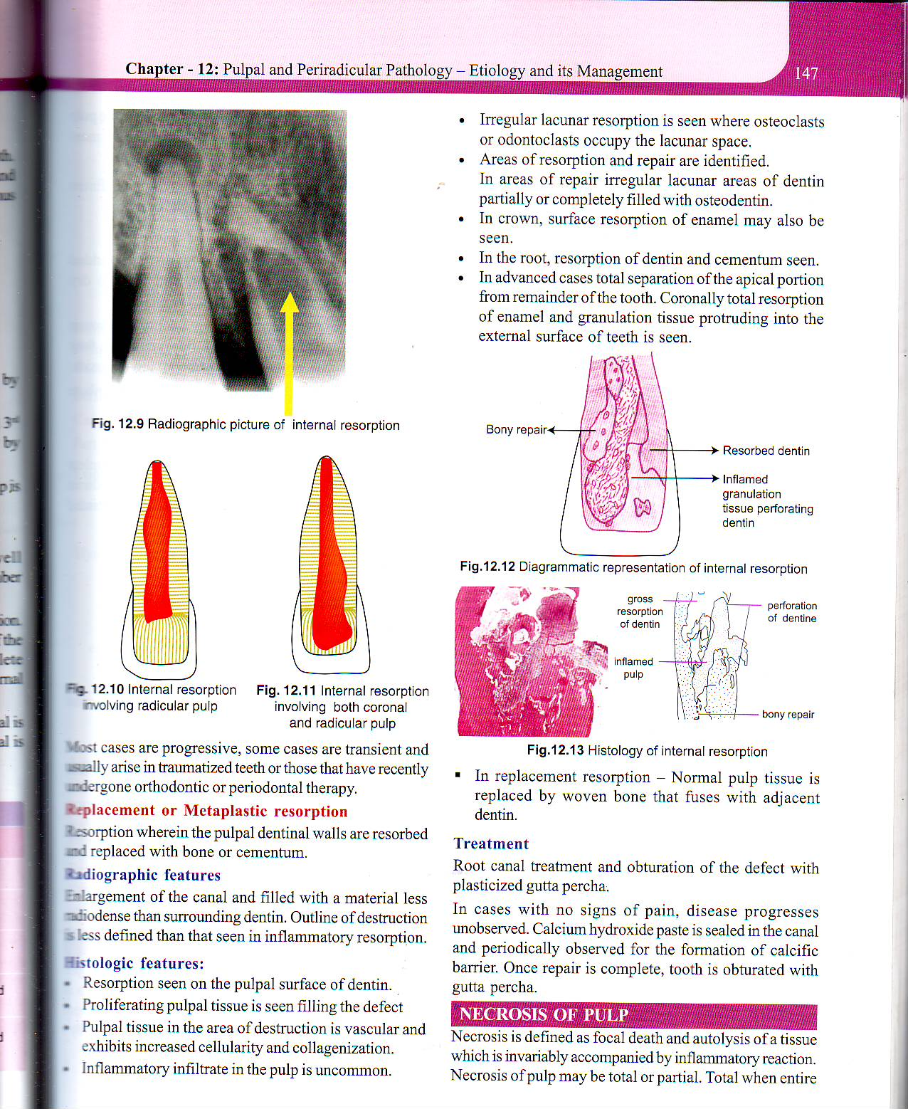
RADIOGRAPHIC APPEARANCE
Areas of destruction appears as an uniform , well circumscribed radiolucent enlargement of the pulp chamber
When coronal pulp is affected – pink discoloration .
Round / ovoid radiolucent area in the coronal portion of the crown
Advance case complete perforation of the tooth & communication with the external surface is seen

Slide 42
Resorption involves root - original outline of canal is lost & balloon like radiographic dilatation of the canal is seen

Slide 43
REPLACEMENT / METAPLASTIC RESORPTION
Pulpal dentinal walls are resorbed & replace with bone / cementum
RADIOGRAPHIC FEATURES
Enlargement of the canal . Outline of destruction is less defined than that seen in inflammatory resorption

Slide 44
TREATMENT
Root canal treatment & obturation of the defect with plasticized gutta percha
In cases with no signs of pain , disease progress unobserved – calcium hydroxide paste is sealed in the canal and observed for calcific barrier periodically .
once repair is complete – tooth is obturated with gutta percha

Slide 45
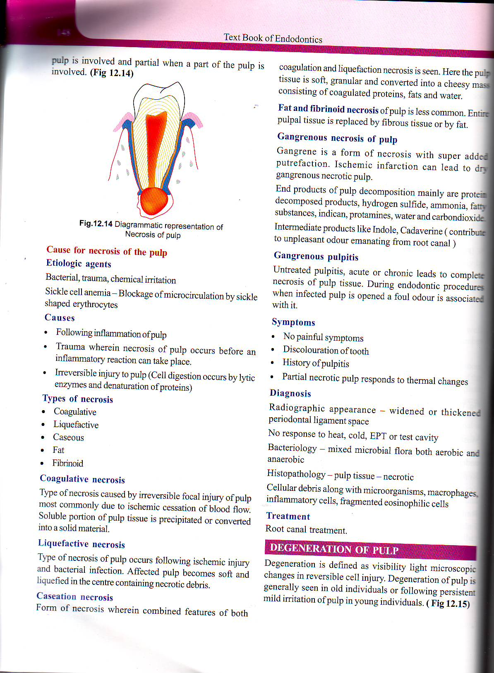
NECROSIS OF PULP
DEFINED – as a focal death & autolysis of a tissue which is invariably accompanied by inflammatory reaction
Necrosis of the pulp --- total / partial
Total – entire pulp is involved
Partial – part of the pulp is involved

Slide 46
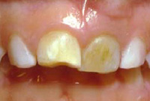

Slide 48
COAGULATIVE NECROSIS
Caused by focal injury of pulp – ischemic cessation of blood flow – soluble portion of the pulp tissue is precipitated / converted into a solid material
LIQUEFACTIVE NECROSIS
Following ischemic injury & bacterial infection.
All effected pulp becomes soft & liquefied in the center containing necrotic debris

Slide 49
FAT & FIBRINOID NECROSIS
Entire pulp tissue is replaced by fibrous tissue / fat
GANGRENOUS PULP
Untreated pulpits , acute/ chronic leads to complete necrosis of pulp tissue – foul odour – root canal is opened

Slide 50
DIAGNOSIS
X-ray – widened / thickened pdl space
No response – heat , cold , EPT / test cavity
TREATMENT
Root canal treatment

Slide 51
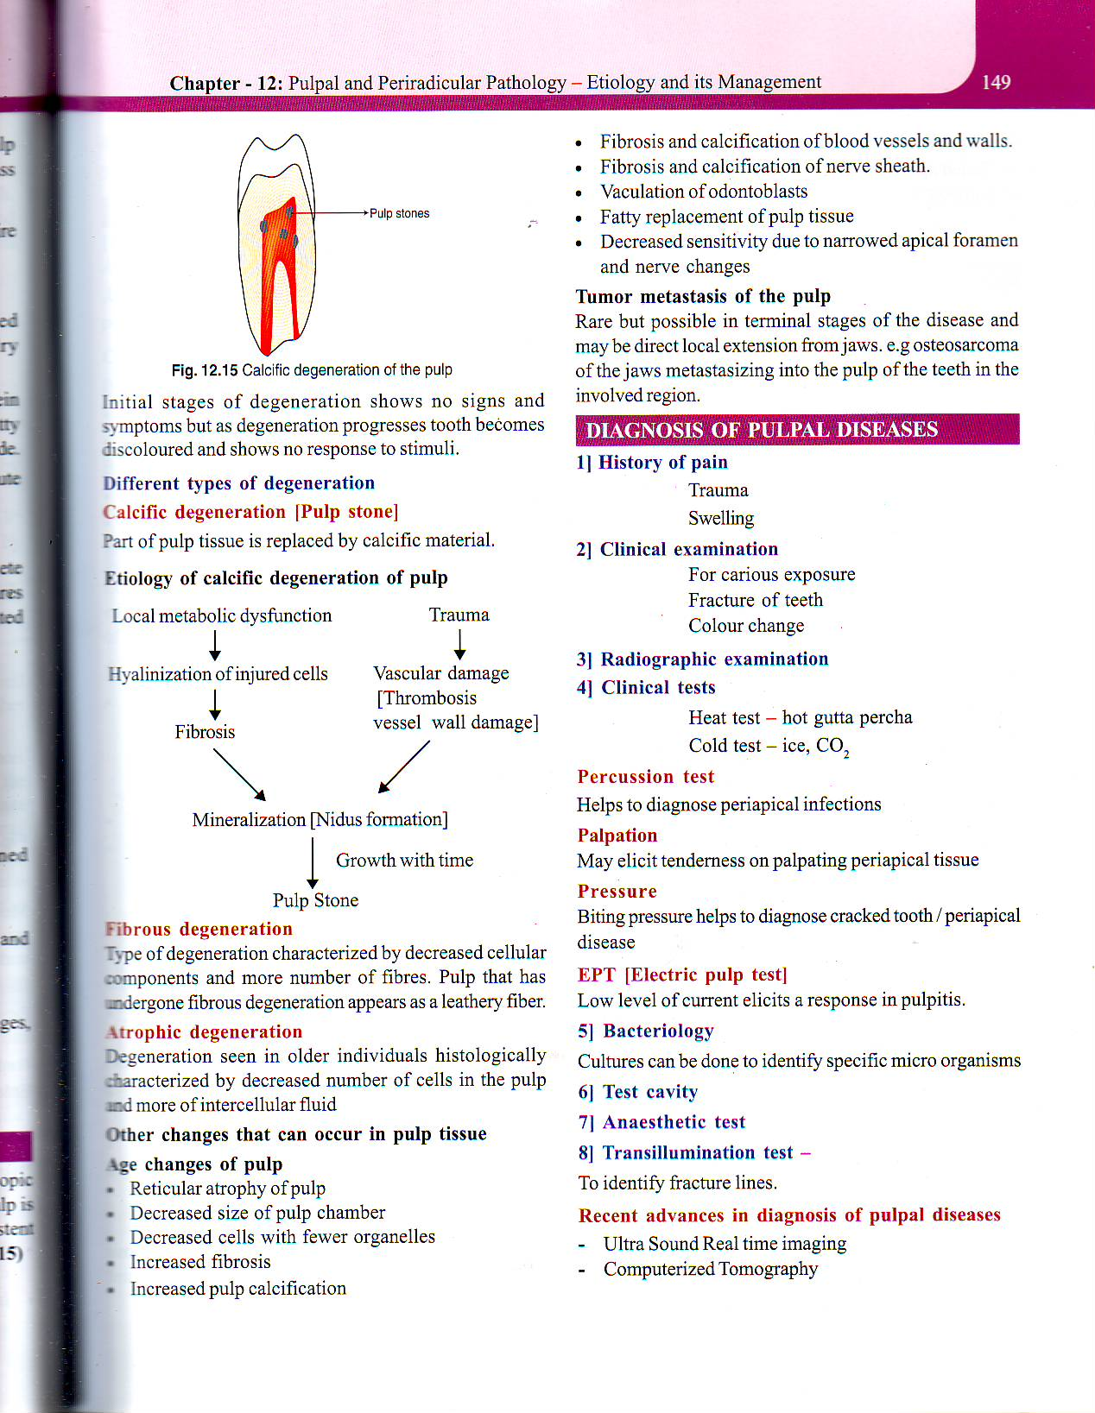
DEGENERATION OF PULP
Defined as visibility light microscopic changes in reversible cell injury
Seen in old individuals / following persistent mild irritation of pulp in young individuals
Initial stages – no signs & symptoms
Becomes discolored & shows no response to stimuli as degeneration progresses

Slide 52
DIFFERENT TYPES OF DEGENERATION
CALCIFIC DEGENERATION ( PULP STONE ) – part of pulp tissue is replaced by calcific material
FIBROUS DEGENERATION – decreased cellular components & more number of fibers - pulp that has undergone fibrous degeneration appears as a leathery fiber
ATROPHIC DEGENERATION - seen in older individuals - characterized by decrease number of cells & more of intercellular fluid

Slide 55
DIAGNOSIS OF PULPAL DISEASES

Slide 56
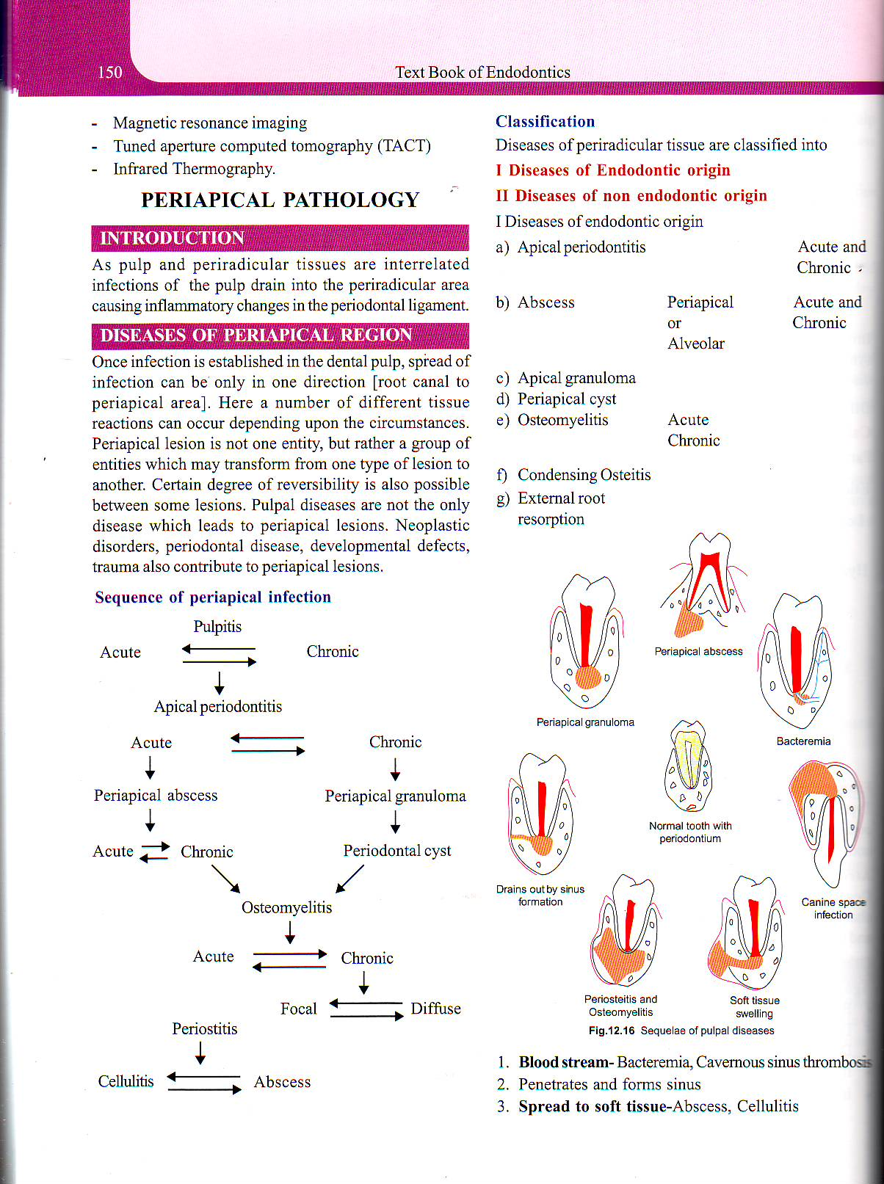

Slide 57
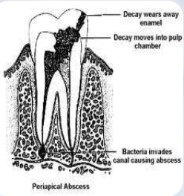
PERIAPICAL PATHOLOGY

Slide 59
There is a pathway between pulp and peri radicular area.
Infected pulp contains- bacterial toxins and immunological factors - slowly seep by various ways to peri radicular area causing
Apical periodontitis
Alveolar abscess
Radicular cyst
Periapical granuloma
Cementoma
Condensing osteitis
Ossifying fibroma

Slide 61
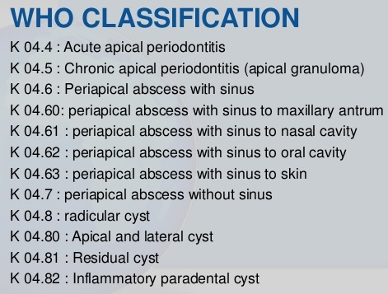
WHO classified AP under diseases of periapical tissues and subdivided it into several category based on clinical signs.

Slide 62
CLASSIFICATION ACCORDING TO GROSSMAN:
1) Acute Periradicular disease
a) Acute alveolar abscess Vital
b) Acute apical periodontitis
Non vital
2) Chronic periradicular disease with areas of
rarefaction
a) Chronic alveolar abscess
b) Granuloma
c) Cyst
3) Condensing osteitis
4) External root resorption
5) Disease of non-endodontic origin

Slide 63
Acc to Ingle:
Symptomatic (acute) apical periodontitis,
Asymptomatic (chronic) apical periodontitis, and
Periradicular cyst
Periradicular granuloma
Apical abscess - symptomatic
- asymptomatic

Slide 64
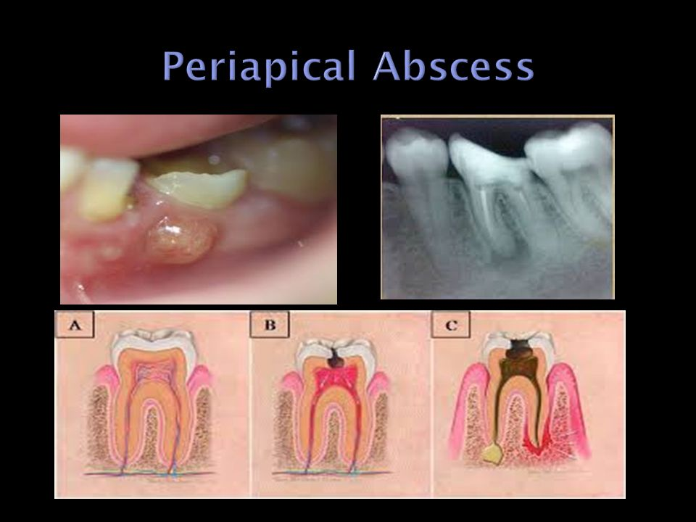
PERIAPICAL ABSCESS ( DENTO ALVEOLAR ABSCESS , ALVEOLAR ABSCESS)
Acute / chronic suppurative process of the dental periapical region
CLASSIFICATION
Periapical abscess is classified based on the duration as
Acute periapical abscess
Chronic periapical abscess
Based on clinical presentation
Symptomatic
Asymptomatic

Slide 65
ACUTE ALVEOLAR ABSCESS
Localized collection of pus in the alveolar bone at the root end of a tooth following death of the pulp & extension of the infection from the pulp into the peri radicular area

Slide 66
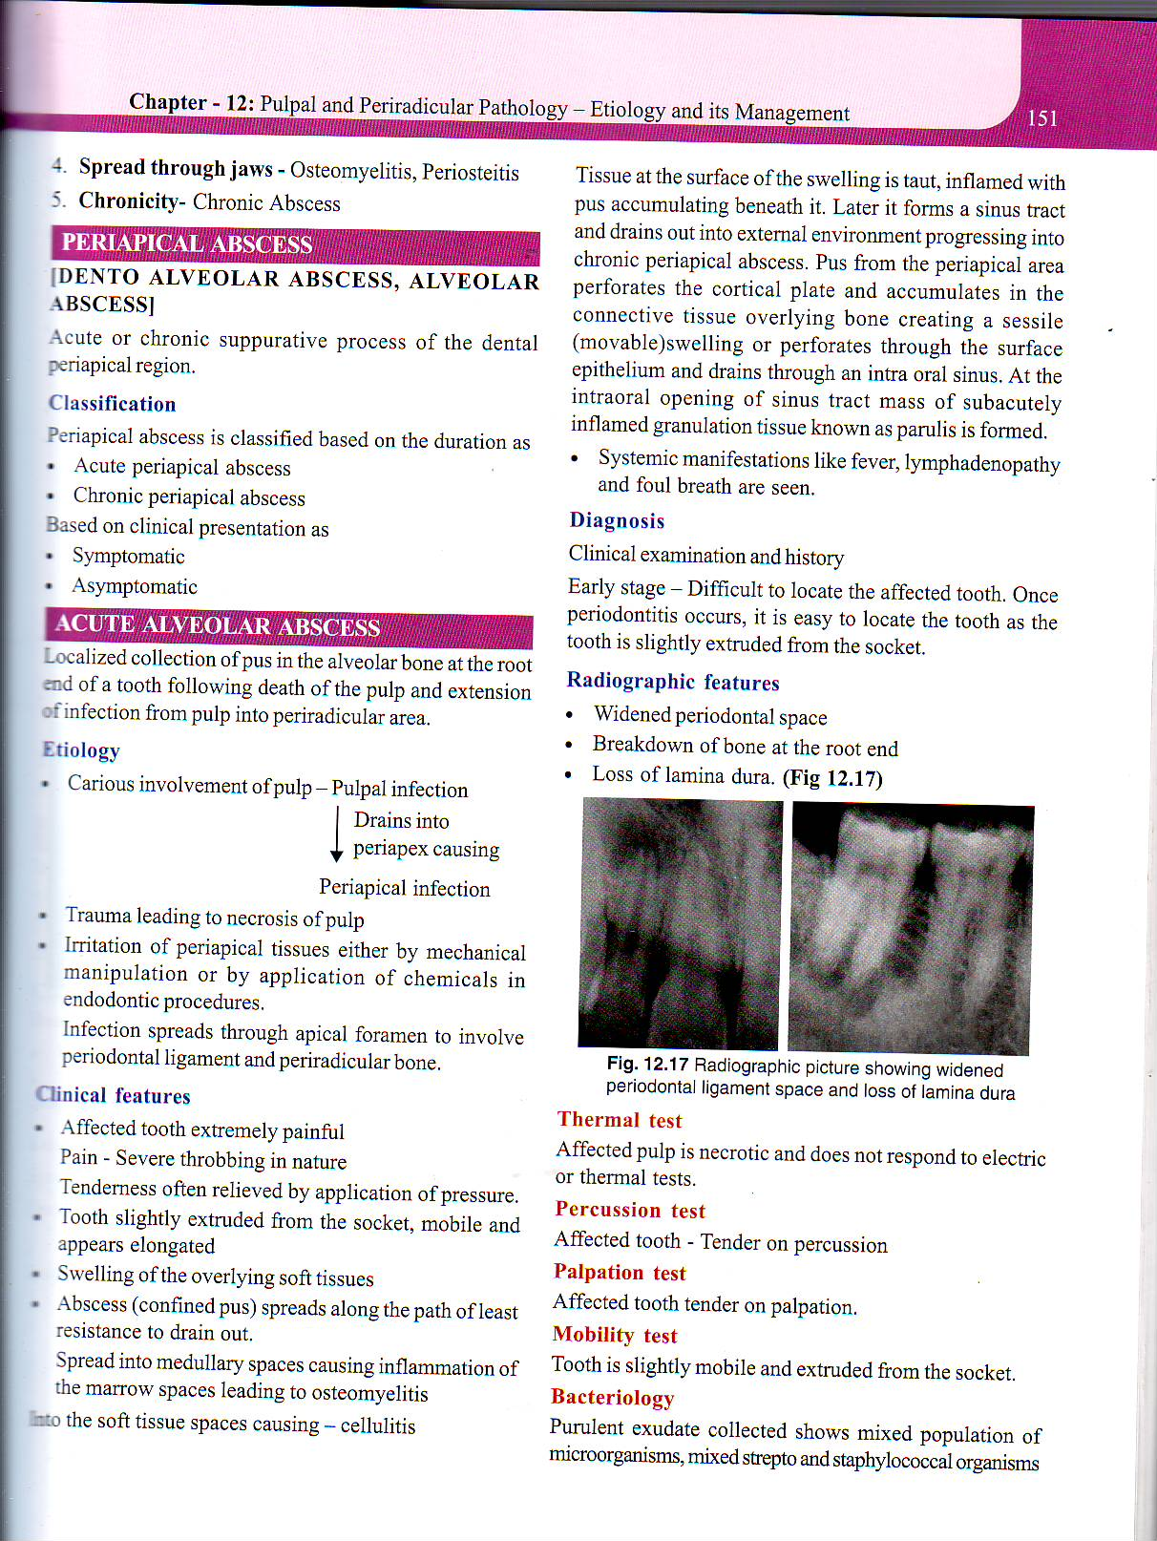
ETIOLOGY

Slide 67
CLINICAL FEATURES

Slide 70
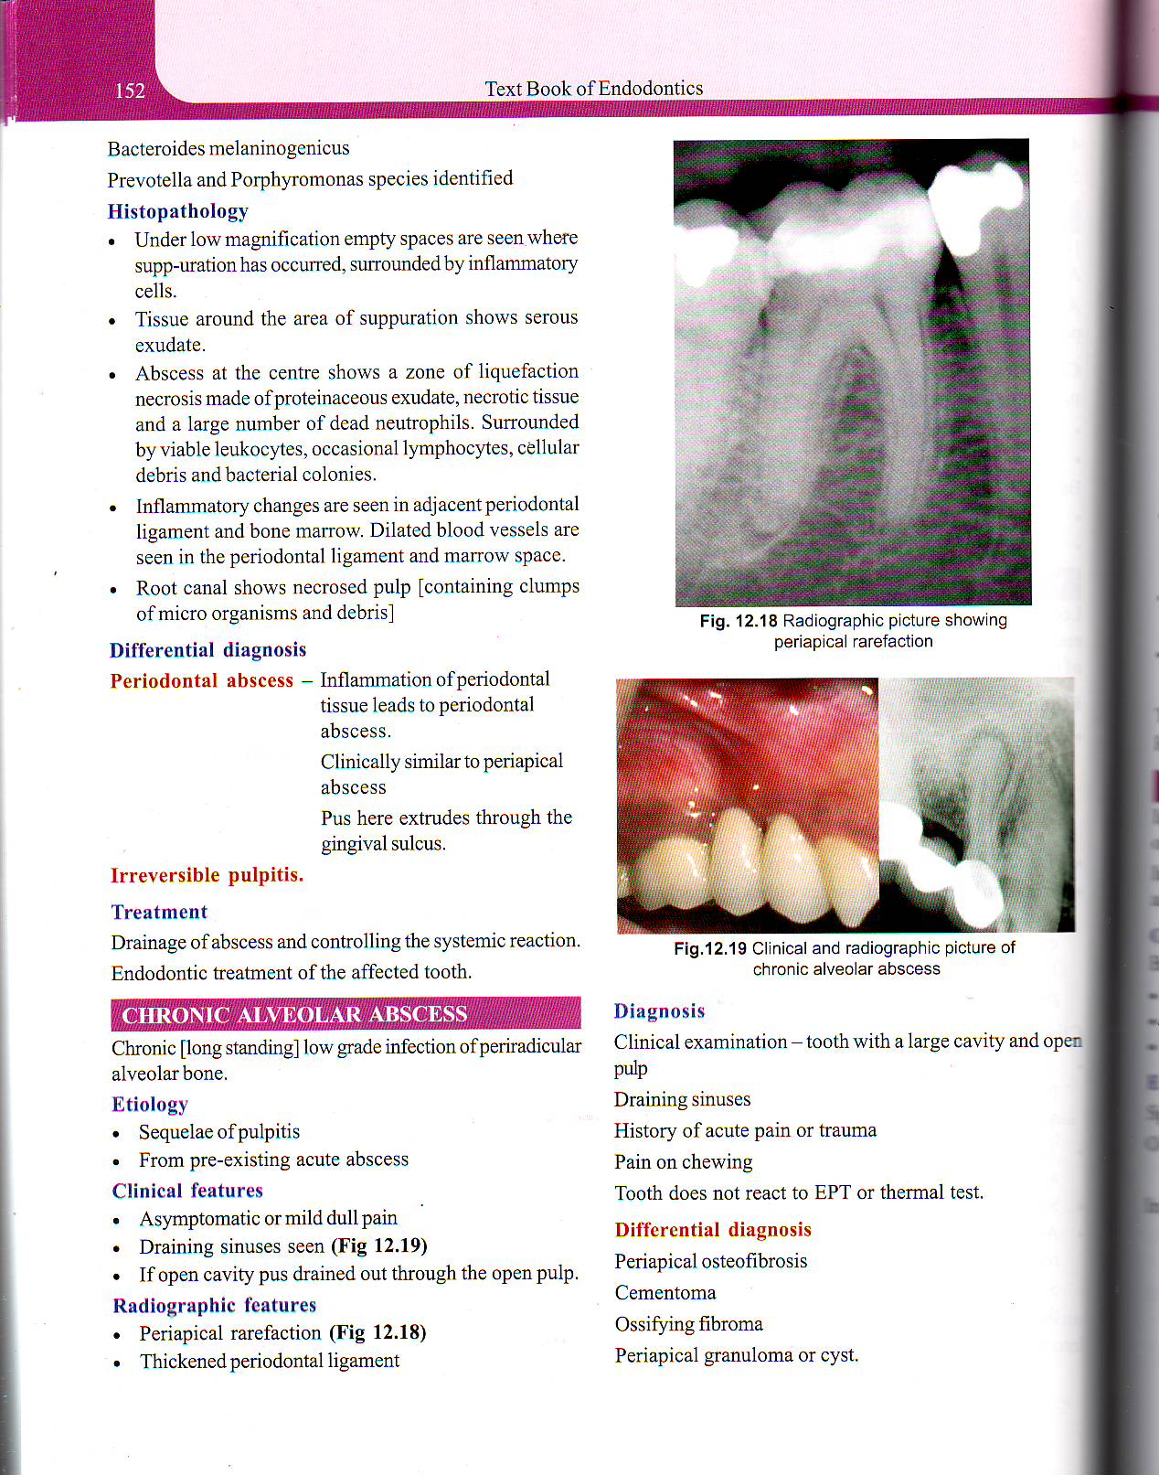

Slide 71
CHRONIC ALVEOLAR ABSCESS

Slide 72
TREATMENT – Root canal therapy

Slide 73
APICAL PERIODONTITIS
localized inflammation of PDL in the apical region .
CLASSIFED - ACUTE / CHRONIC
- Asymptomatic / Symptomatic

Slide 74
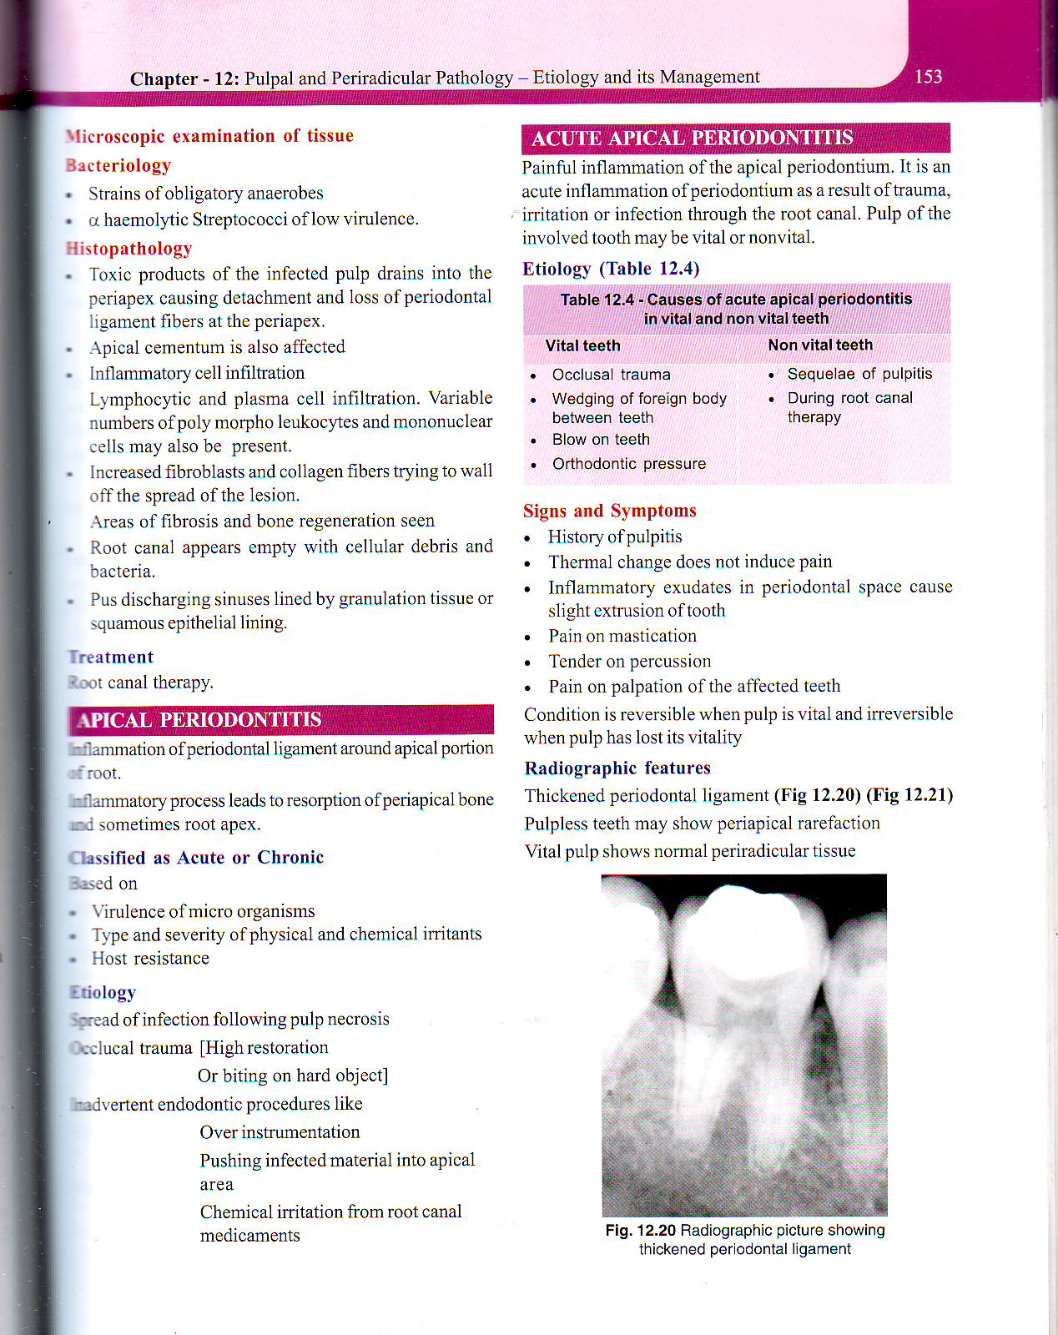
ETIOLOGY

Slide 75
CLINICAL FEATURES
Pain varies from slight tenderness to excruciating pain on mastication
Tenderness on vertical percussion
Tooth may or may not respond to vitality tests

Slide 76
ACUTE APICAL PERIODONTITIS
Pulp of the involved tooth may be vital / nonvital
ETIOLOGY - VITAL & NONVITAL TOOTH

Slide 77
SIGNS & SYMPTOMS

Slide 78
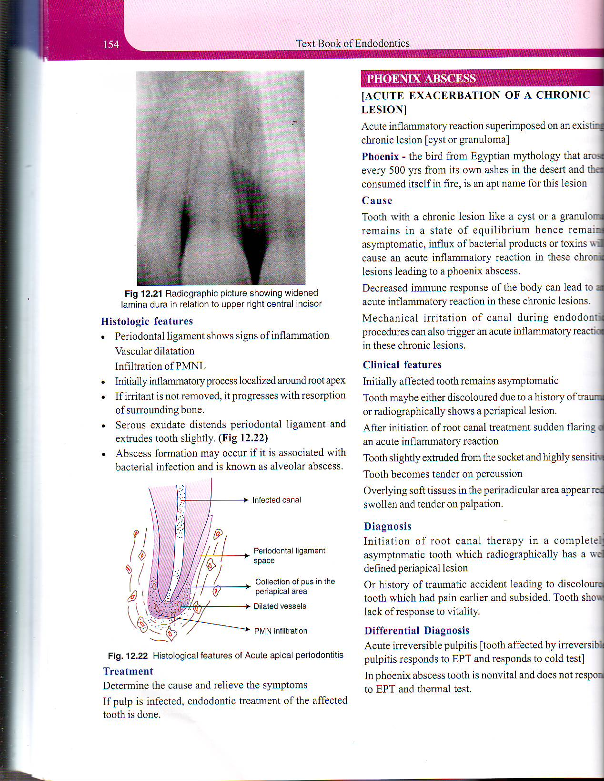
RADIOGRAPHIC FEATURES

Slide 79
PHOENIX ABSCESS
( ACUTE EXACERBATION OF A CHRONIC LESION )
Acute inflammatory reaction superimposed on an existing chronic lesion ( cyst / granuloma)
CAUSE
Tooth with chronic lesions like cyst / a granuloma-asymptomatic – influx of bacterial products / toxins will cause an acute inflammatory reaction in these chronic lesions leading to phoenix abscess
Decreased immune response of the body – acute inflammatory reaction in these chronic lesions
Mechanical irritation of canal during endo procedures – trigger an acute inflammatory reaction in these chronic lesions

Slide 80
CLINICAL FEATURES
Initially – asymptomatic
Tooth – discolored – trauma / x-ray – periapical lesion
Sudden flare – RCT / acute inflammatory reaction
Tooth – extruded from socket
Tender on percussion
Overlying soft tissue – swollen & tender on percussion
No Response – vitality

Slide 81
DIFFERENTIAL DIAGNOSIS
Acute irreversible pulpitis ( tooth affected by irreversible pulpitis responds to EPT & responds to cold test )
In phoenix abscess – tooth - nonvital – doesn't respond to EPT & thermal test
TREATMENT
Treated as endodontic emergency with antibiotic coverage

Slide 82
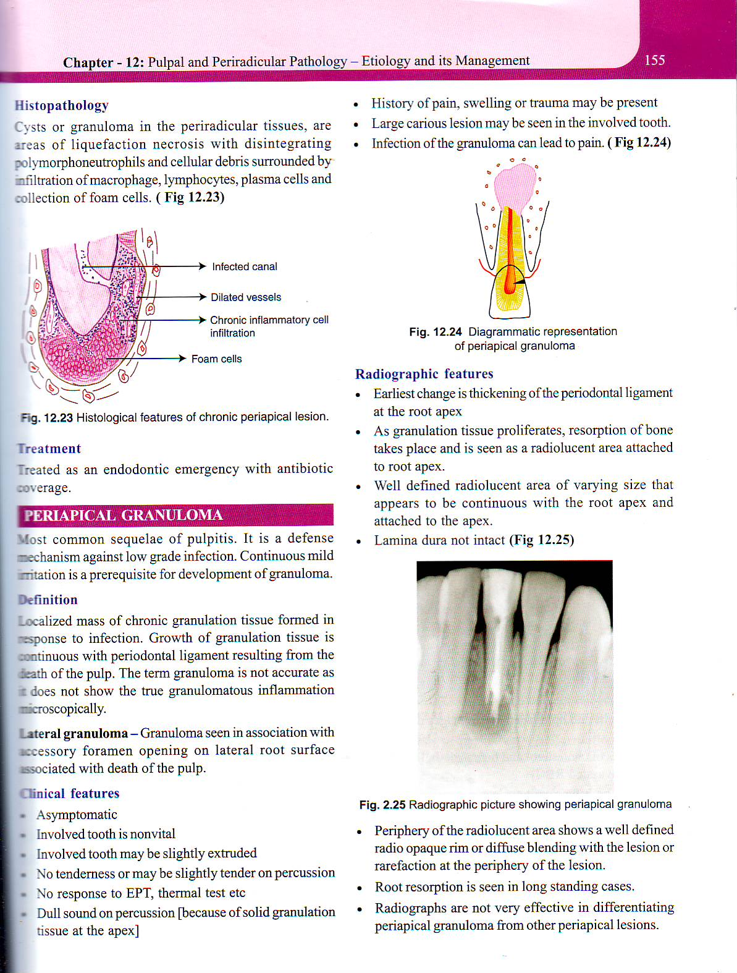
PERIAPICAL GRANULOMA
Common squeale of pulpitis
DEFINITION
Localized mass of chronic granulation tissue formed in response to infection

Slide 83
CLINICAL FEATURES
Asymptomatic
Nonvital
Extruded tooth
Dull sound on percussion
EPT , Thermal test – no response
H/O pain , swelling / trauma – may be present
Large carious lesion – involved tooth
Infection of granuloma – pain

Slide 84
RADIOGRAPHIC FEATURES
Earliest – thickening of Pdl at the apex
Well defined radiolucent area-appears continuous with the root apex & attached to root apex
Lamina dura not intact
Root resorption is seen in long standing cases

Slide 85
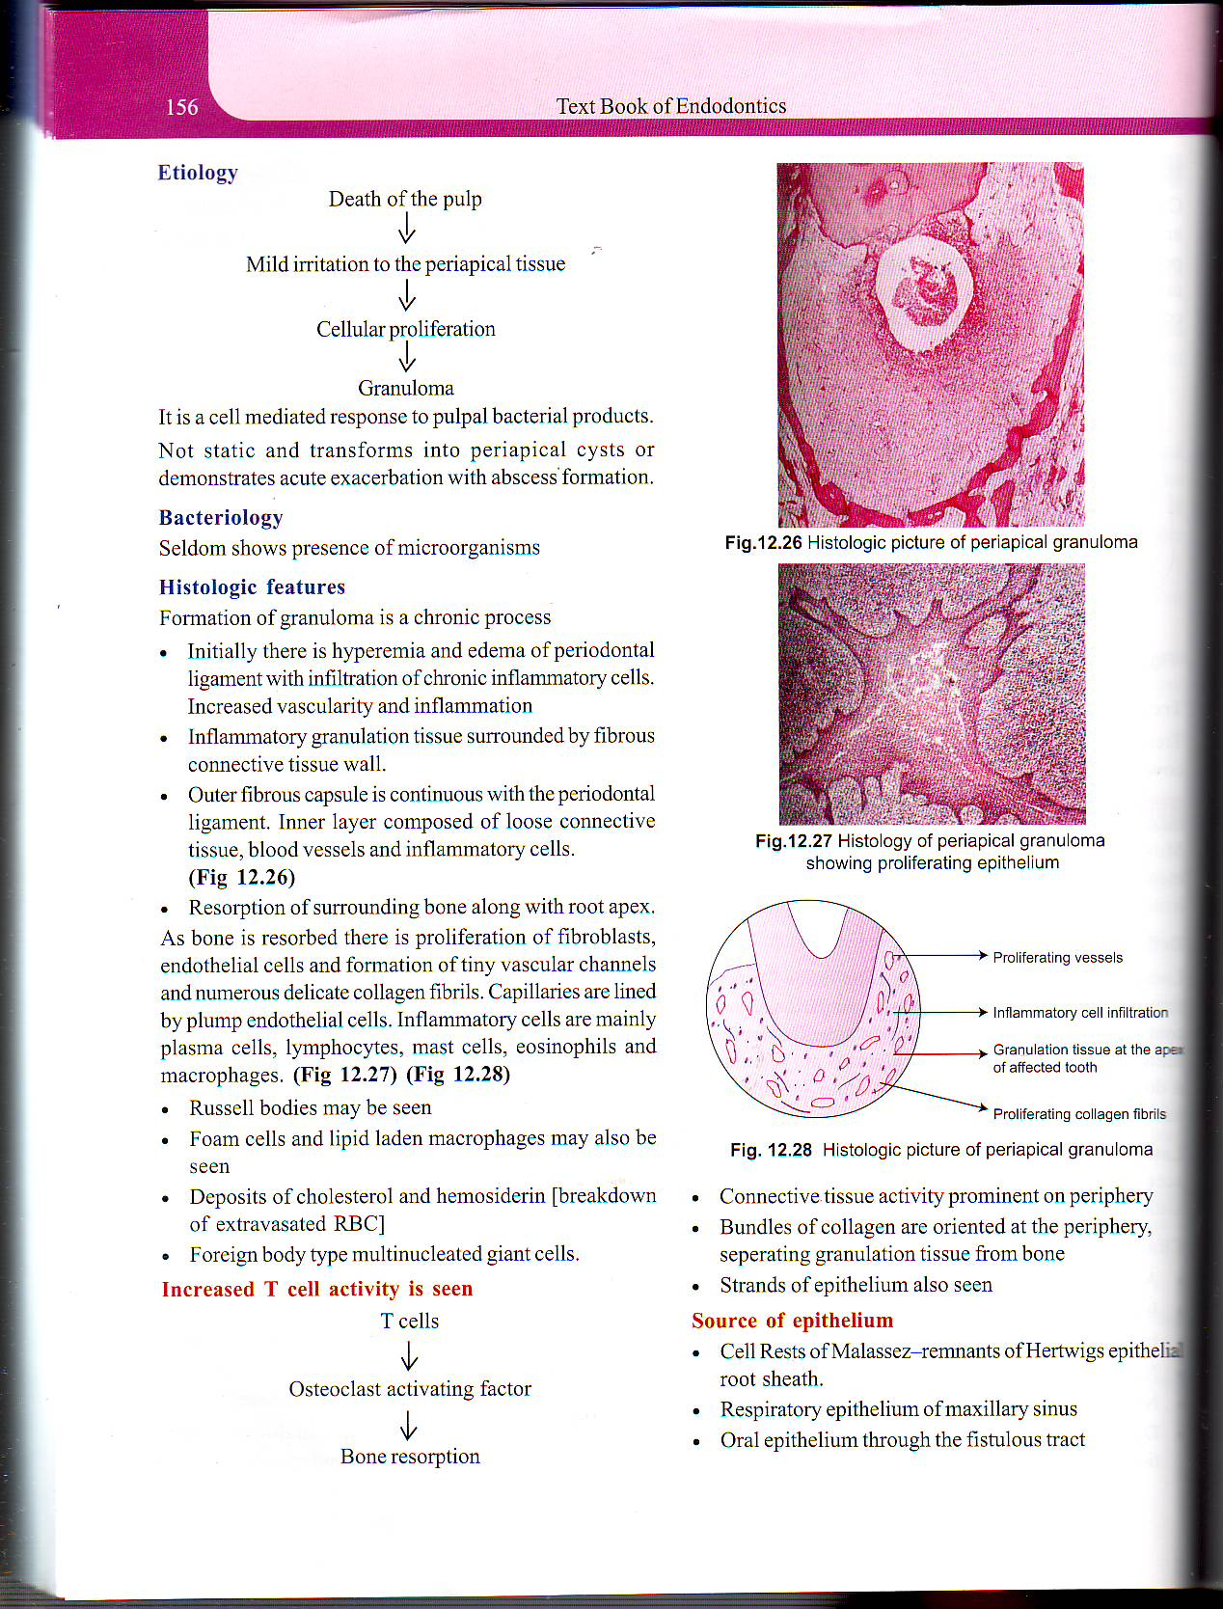
ETIOLOGY

Slide 86
TREATMENT
Root canal treatment with apicectomy
If left untreated – peripaical cyst

Slide 87
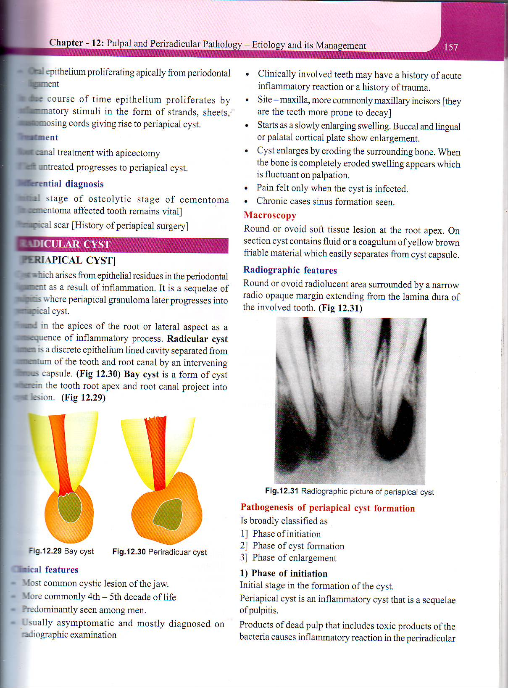
RADICULAR CYST ( DENTAL CYST ,PERIAPICAL CYST )
Cyst which arises from epithelial residues in the periodontal ligament as a result of inflammation
Sequeale of pulpitis – periapical granuloma later progresses into periapical cyst
Radicular cyst – lumen is a discrete epithelium lined cavity separated from cementum of the tooth & root canal by a intervening fibrous capsule

Slide 88
Bay cyst – is a form of cyst wherein the tooth root apex & root canal project into cyst lesion

Slide 89
CLINICAL FEATURES
History of trauma
Maxillary teeth are commonly involved
Pain – cyst is infected
Chronic- sinus formation

Slide 90
RADIOGRAPHIC FEATURES

Slide 91
Definitive diagnosis is possible by histo pathology – cholesterol crystals in cystic fluid – seen under microscope
Recently non invasive methods like echograghy & CT scan are used for diagnosis

Slide 92
TREATMENT
SURGICAL ENUCLEATION
in few cases – resolution is observed following RCT

Slide 93
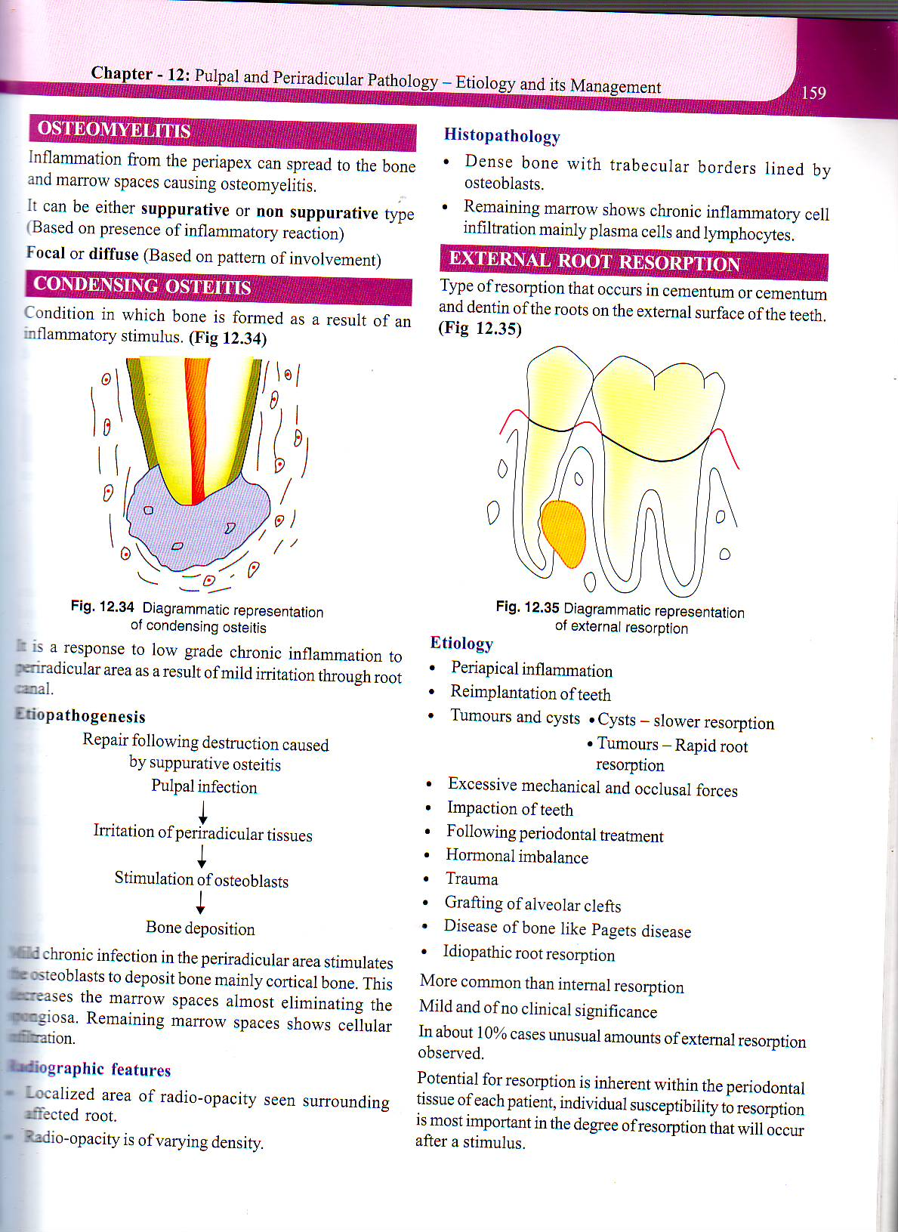
EXTERNAL ROOT RESORPTION
Type of resorption that occurs in cementum & dentin of the roots on the external surface of the teeth

Slide 94
ETIOLOGY
PERIAPICAL INFLAMMATION
REIMPLANTATION
TUMORS & CYSTS
IMPACTION
EXCESSIVE MECHANICAL & OCCLUSAL STRESS
TRAUMA
GRAFTING
PAGETS DISEASE OF BONE
IDIOPATHIC ROOT RESORPTION

Slide 95
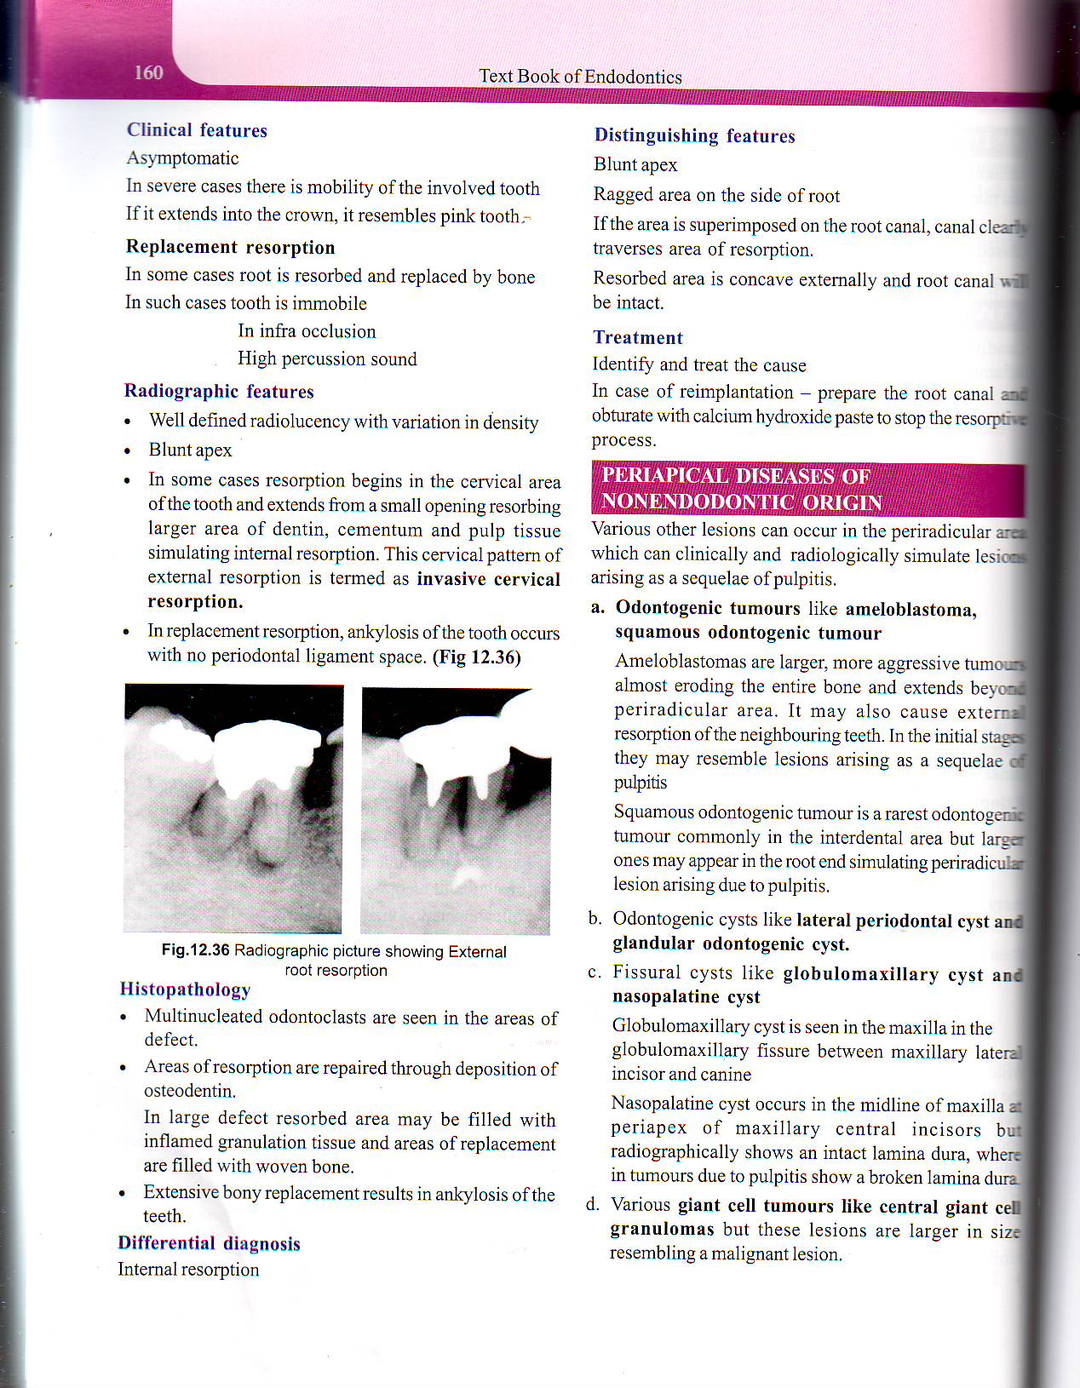
CLINICAL FEATURES
Asymptomatic
Sever – mobility
Extends –crown – resembles pink tooth

Slide 96
RADIOGRAPHIC FEATURES

Slide 97
DISTINGUISHING FEATURES
Blunt apex
Ragged areas on the side of the root
Resorbed area is concave externally & root canal is intact

Slide 98
TREATMENT
Identify & treat the cause
In case of reimplantation – prepare the root canal & obturate with calcium hydroxide paste to stop the resorptive process

Slide 99
PERI APICAL DISEASE OF NON ENDODONTIC ORIGIN
Lesions can occur in the periradicular area which can clinically & radiologically simulate lesions arising as a sequele of pulpitis
ODONTOGENIC TUMORS – Ameloblastoma , Squamous odontogenic tumor
CYSTS – Lateral periodontal cysts & Nasoplatine cysts
FISSURAL CYSTS- Globulomaxillary cysts
GAINT CELL TUMORS – Central gaint cell granulomas
METASTATIC TUMORS OF THE JAWS & OSTEOSARCOMAS OF THE JAW

